Slide 1

Exception Handling in Python

Slide 2
Background
An exception is a Python object that represents an error
When a function raises an exception, the function must either handle the exception immediately or terminate.
If the function doesn’t handle the exception, the caller may handle it.
If not, the caller also terminates immediately as well.
The exception propagates up the call-stack until someone handles the error. If nobody catches the exception, the whole program terminates.

Slide 3
Handling an Exception
If you have some “suspicious” code that may raise an exception, you can defend your program by placing the suspicious code in a try: block.
After the try: block, include an except statement, followed by a block of code which handles the problem
An exception can have an argument, which is a value that gives additional information about the problem. The contents (and even the type) of the argument vary by exception
You capture an exception’s argument by supplying a variable in the except clause: except ExceptionType, ArgumentVariable

Slide 4
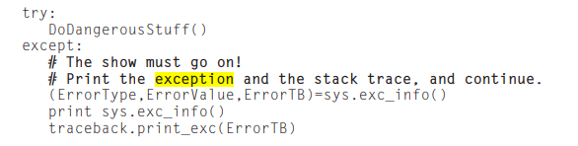
You can supply several except clauses to handle various types of exceptions. In this case, exceptions are handled by the first applicable except clause. You can also provide a generic except clause, which handles any exception.
Python raises an IOError exception if you try to open a file that doesn’t exist. Here is a snippet of code that handles a missing file without crashing

Slide 5
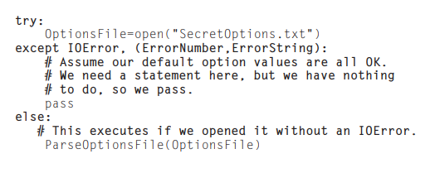

Slide 6
Defining & Raising Exceptions
You can raise exceptions with the statement raise exceptionType,argument.
ExceptionType is the type of exception (for example, NameError).
Argument is a value for the exception argument. Argument is optional; if not supplied, the exception argument is None.
An exception can be a string, a class, or an object. Most of the exceptions that the Python core raises are classes, with an argument that is an instance of the class. Defining new exceptions is quite easy, as this contrived example demonstrates:

Slide 7
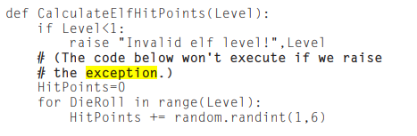
In order to catch an exception, an “except” clause must refer to the same exception thrown. Python co

Slide 8
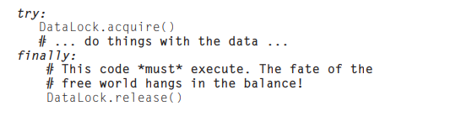
Finally
An alternative mechanism for coping with failure is the finally block. The finally block is a place to put any code that must execute, whether the try-block raised an exception or not. You can provide except clause(s), or a finally clause, but not both.
For example, multithreaded programs often use a lock to prevent threads from stomping on each other’s data. If a thread acquires a lock and crashes without releasing it, the other threads may be kept waiting forever

Slide 9
Assertions in Python
An assertion is a sanity-check that you can turn on or turn off
Using an assertion can help make code self-documenting; raising an AssertionError implies that a problem is due to programmer error and not normal problems.
Programmers often place assertions at the start of a function to check for valid input, and after a function call to check for valid output.
You can add assertions to your code with the syntax assert . When it encounters an assert statement, Python evaluates the accompanying expression, which is hopefully true. If the expression is false, Python raises an AssertionError.

Slide 10
You can include an assertion argument, via the syntax assert Expression,ArgumentExpression. If the assertion fails, Python uses ArgumentExpression as the argument for the AssertionError
For example, here is a function that converts a temperature from degrees Kelvin to degrees Fahrenheit. Since zero degrees Kelvin is as cold as it gets, the function bails out if it sees a negative temperature:

Slide 11
